Slide 1
Book me an Appointment
2017 Spring UMKC & H&R Block Hackathon
Use Case Y12: Conversation App By Yoodle
Arun Rattan, M.Tech., M.S., M.B.A
Jyothi Kiran Nandanamudi
Sai Venkatesh Gatiganti
Naveena Nallamothu
Madhuri Gumma

Slide 2

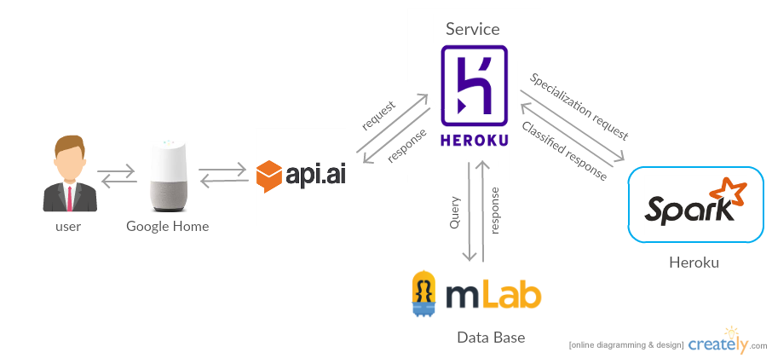
Architecture

Slide 3
Training The Naïve Bayes Model
Data on specialization is fed to NLP:
Tokenizer → Stop Word Removal → TF-IDF → Feature Vectors
Training:
Feature Vectors → Naïve Bayes Model → Model Generation

Slide 4
Testing
Taking the text sent from the service related to the problem user having.
Tokenization
Tokenizes the words in the form of text
Stop Word Removal
Removes the most commonly used words
TF-IDF
It is used as a weighting factor based on the number of times the word appears in the words list.
It converts to feature vectors.
Prediction
Feature Vectors → Naïve Bayes → Specialization Class

Slide 5
What’s going on in service ?
Specialization Request:
The text related to problem is sent to Naïve Bayes Classification model already generated and hosted in Heroku and result is specialization class.
Database Query:
Corresponding doctor for that class has been identified based on the choice of the user.
Appointment Scheduling:
Appointment for that particular doctor will be scheduled according to the time given by user.

